Slide 1
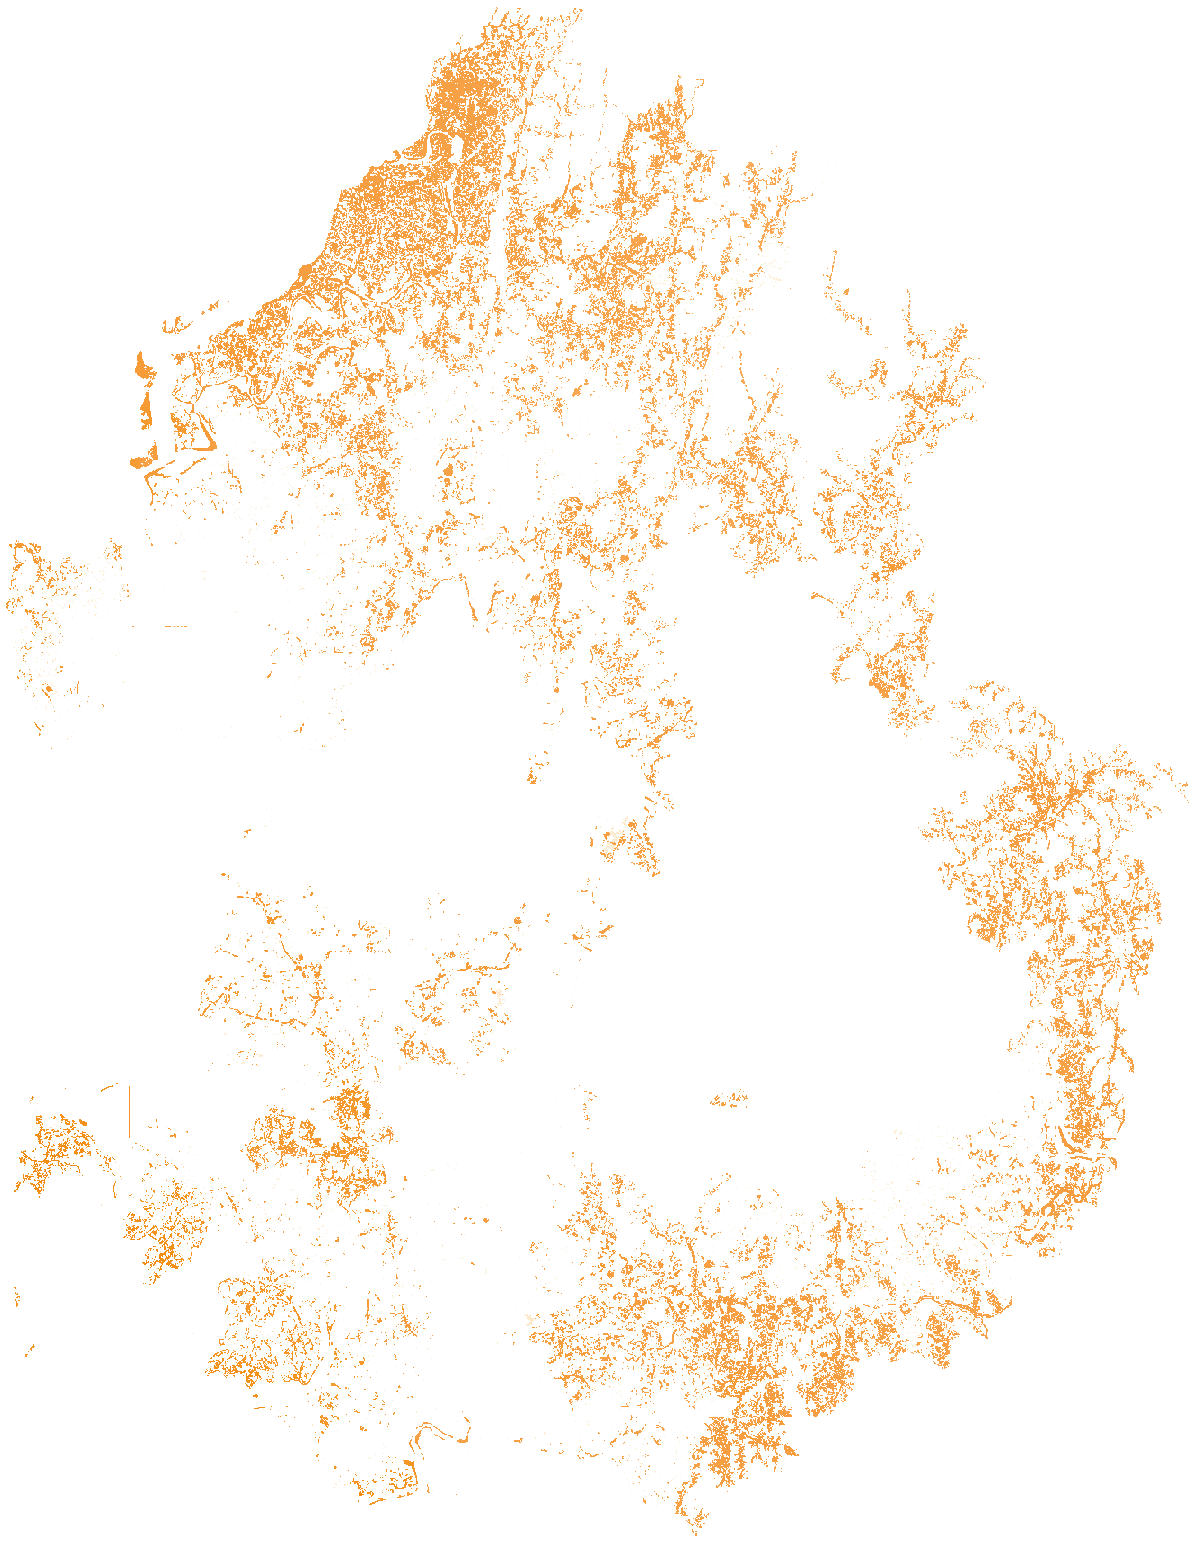
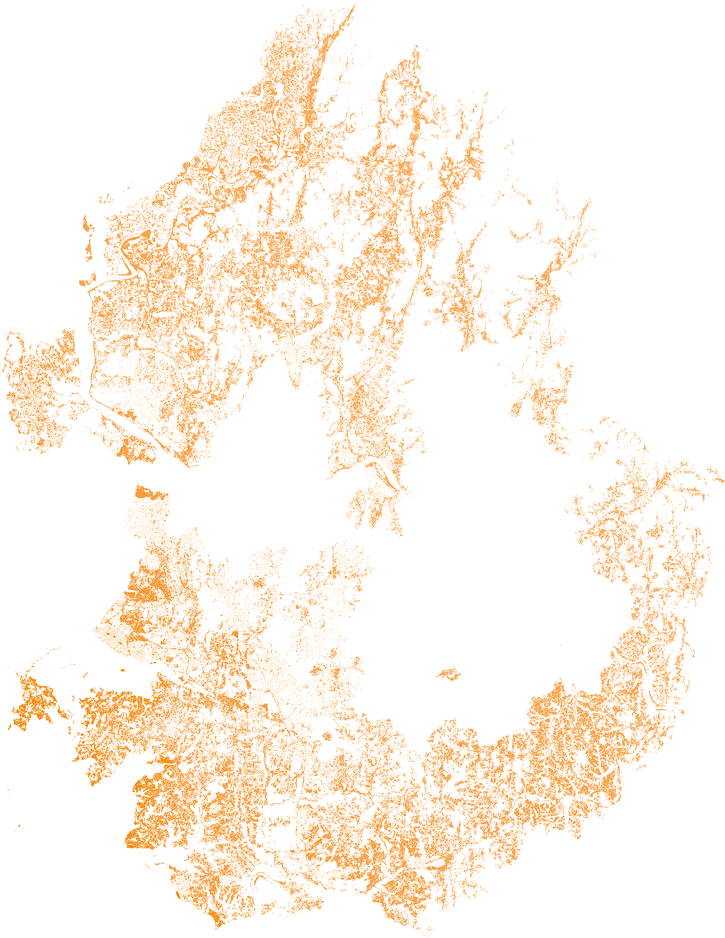
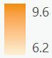
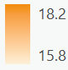
(a) KIER
MWh/m²/year
(b) NIMS
MWh/m²/year

Slide 2
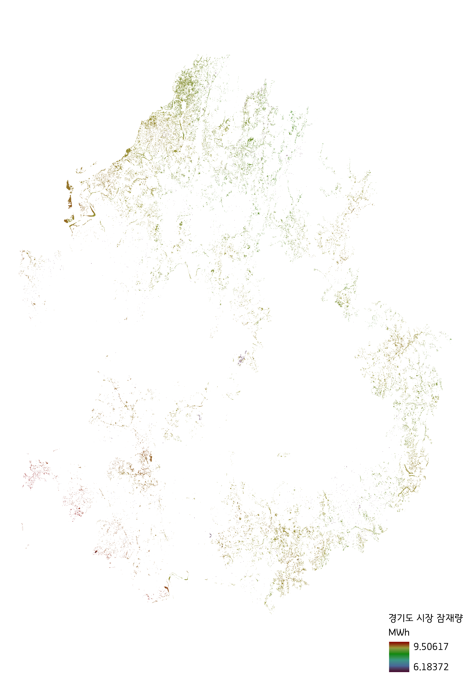
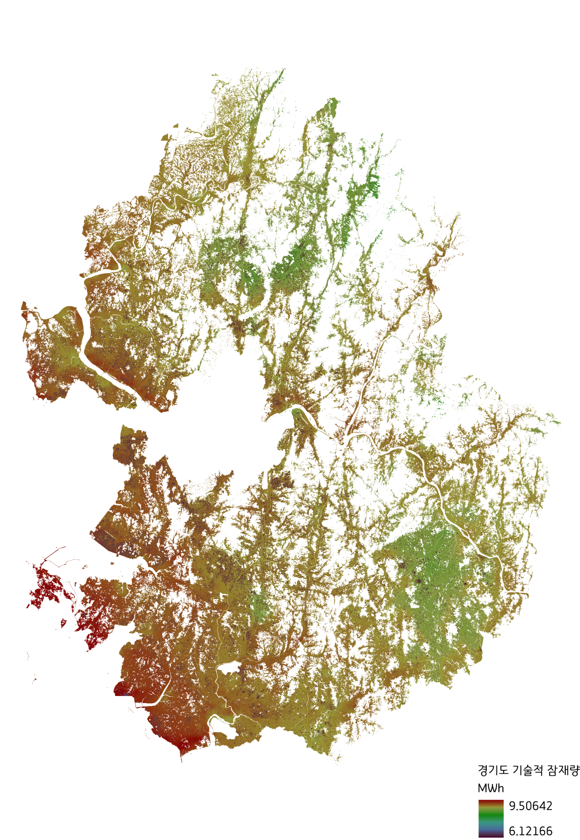
a) Technical potential
(b) Market potential

Slide 3
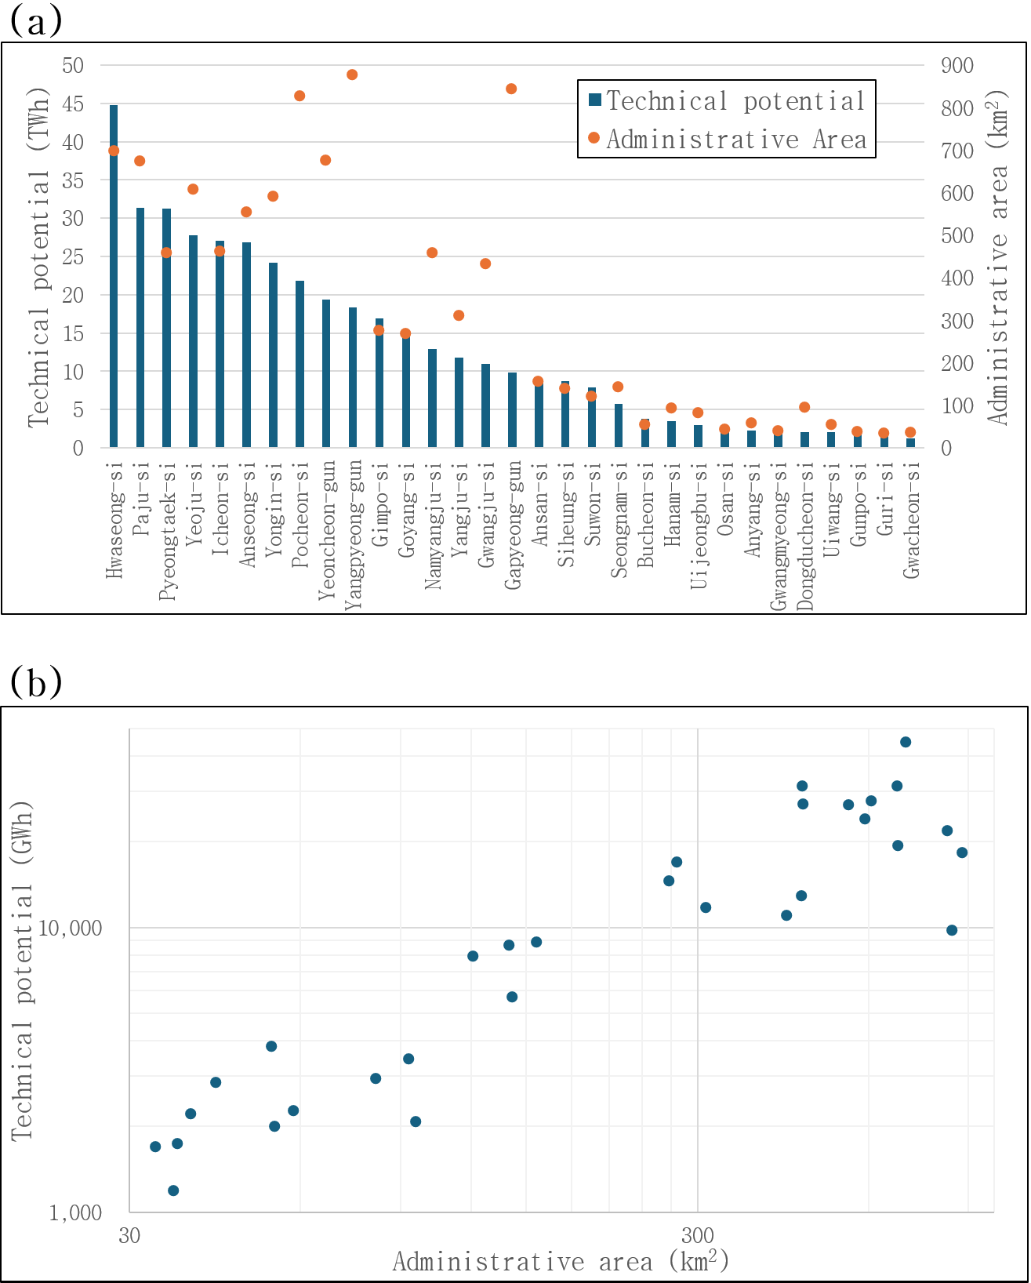
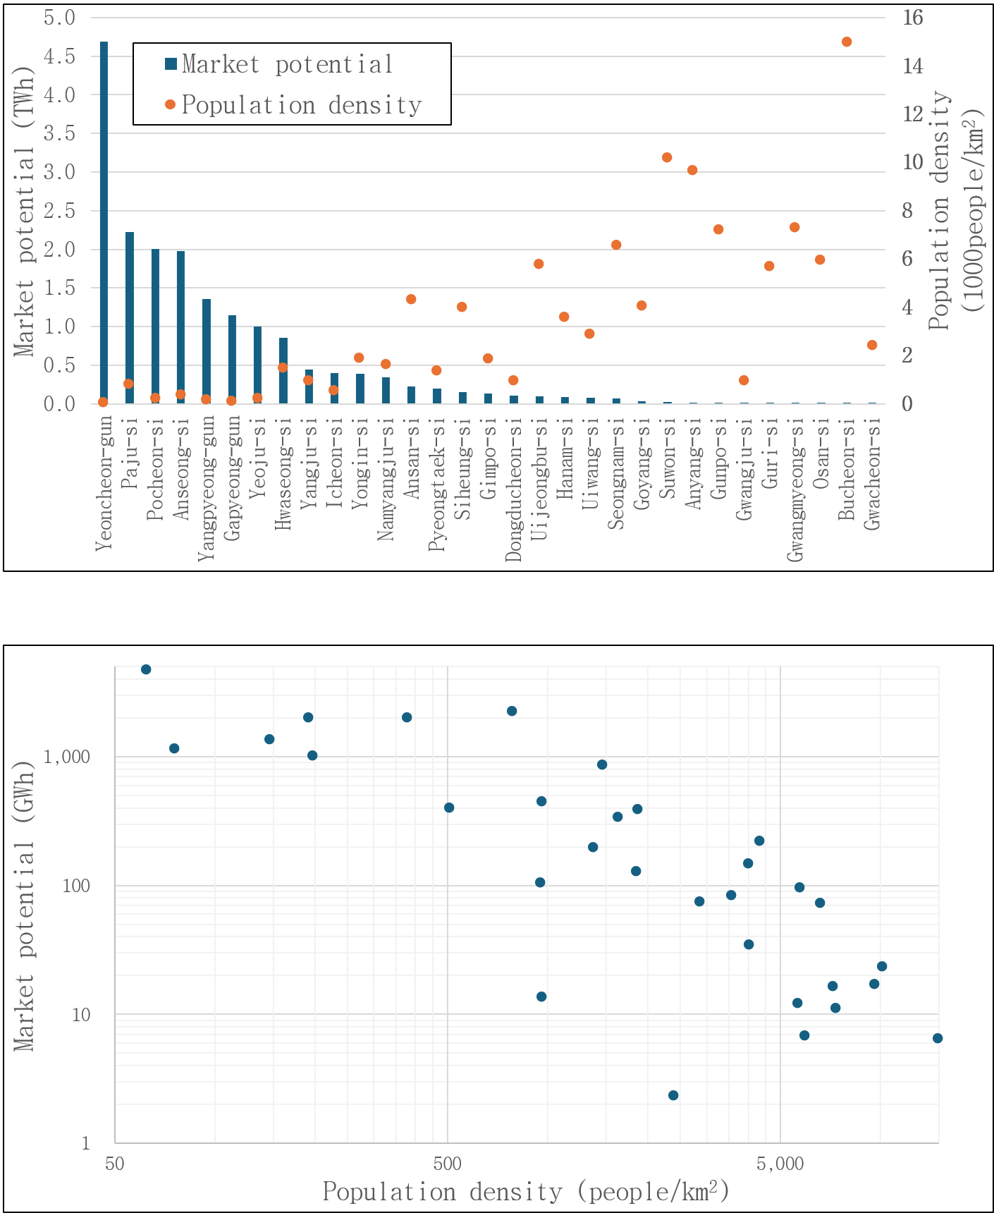
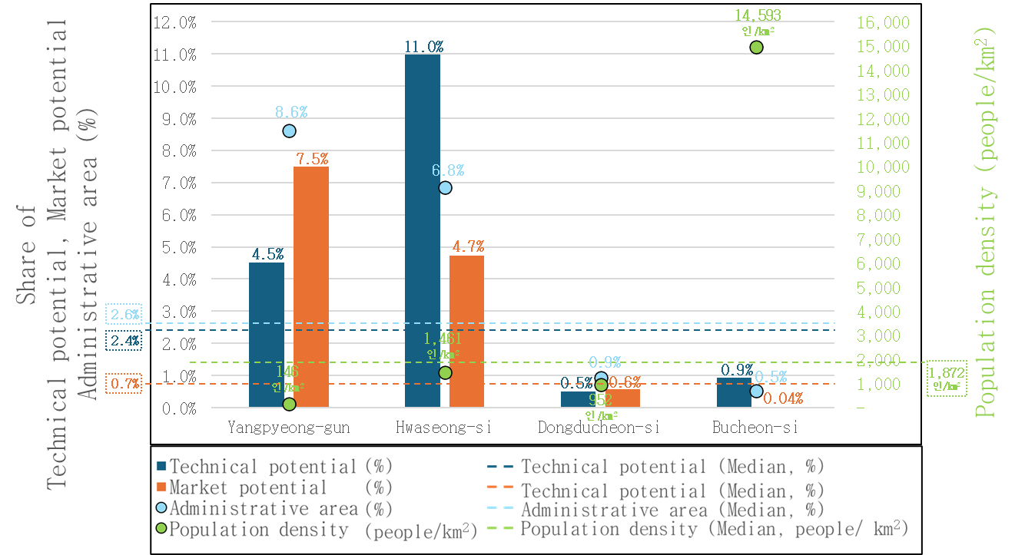
(a) Ranked distribution of technical potential and administrative area
(c) Ranked distribution of market potential and population density
(b) Relation between technical potential and administrative area
(d) Relation between market potential and population density
(e) Comparison of selected municipalities

Slide 4
(a)
(a)
(b)
(b)

Slide 5
(c)
(d)

Slide 6
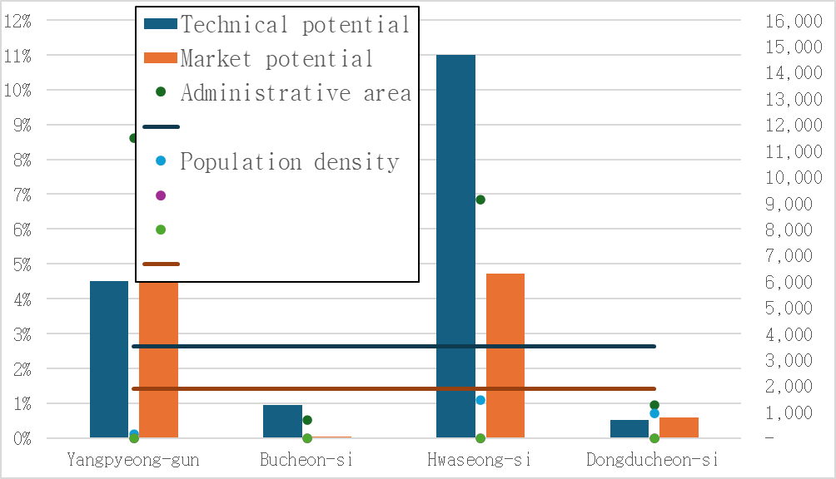

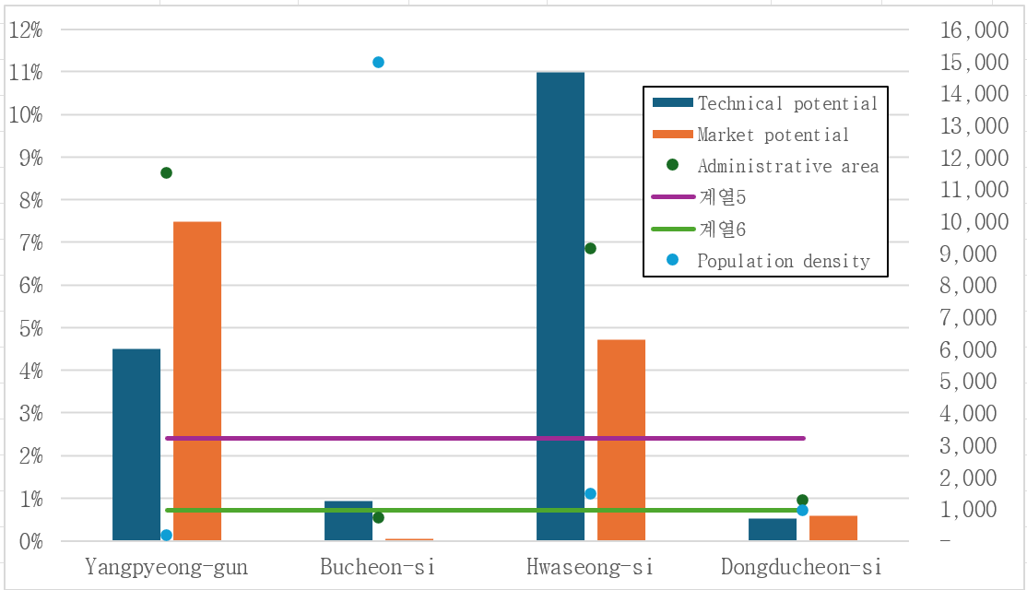
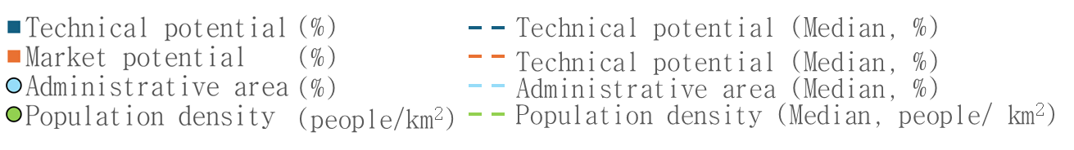
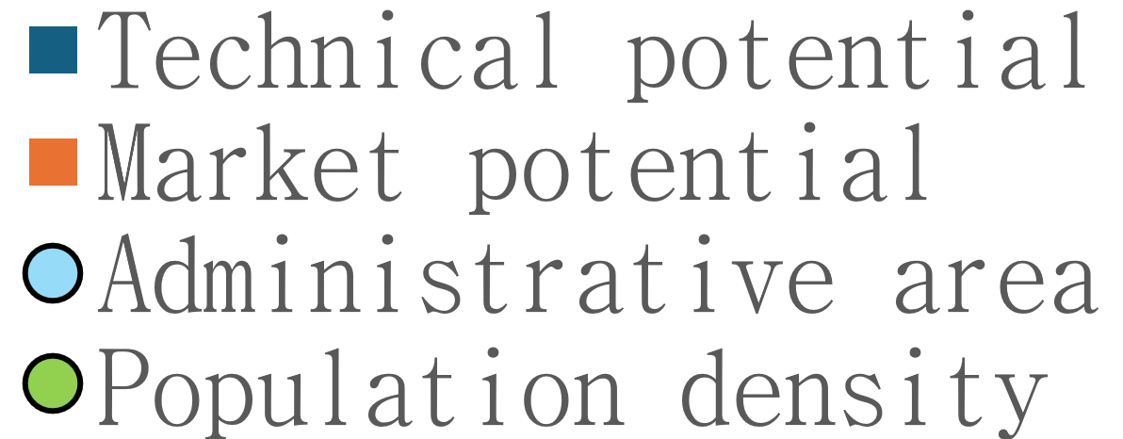
(e)
14,593
인/km²
11.0%
8.6%
7.5%
6.8%
Population density (people/km²)
Share of
Technical potential, Market potential
Administrative area (%)
4.5%
4.7%
2.6%
2.4%
1,461
인/km²
0.7%
0.9%
0.9%
146
인/km²
0.5%
0.6%
0.5%
1,872
인/km²
952
인/km²
0.04%
(%)
Technical potential (Median, %)
(%)
Technical potential (Median, %)
(%)
Administrative area (Median, %)
(people/km²)
Population density (Median, people/ km²)

Slide 7
(e)
14,593
인/km²
11.0%
8.6%
7.5%
6.8%
Population density (people/km²)
Share of
Technical potential, Market potential
Administrative area (%)
4.5%
4.7%
2.6%
2.4%
0.9%
0.9%
1,872
0.7%
0.5%
0.6%
0.5%
14,593
인/km²
0.04%
(%)
Technical potential (Median, %)
(%)
Technical potential (Median, %)
(%)
Administrative area (Median, %)
(people/km²)
Population density (Median, people/ km²)

Slide 8
